Slide 1
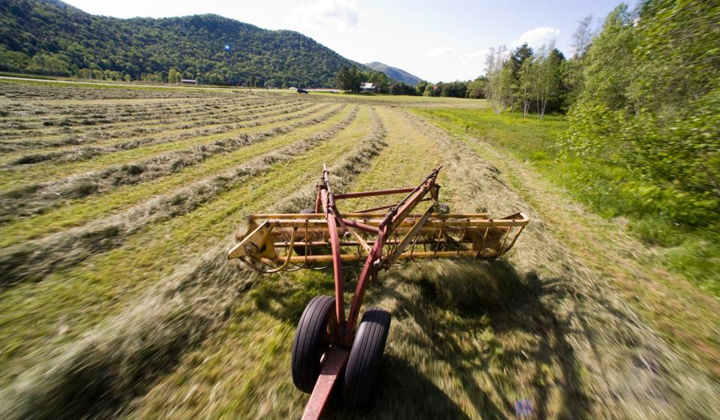
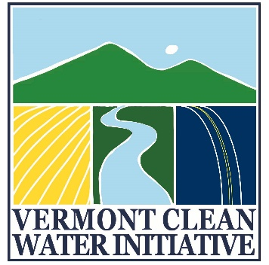

Act 64 Implementation:
Required Agricultural Practices (RAPs)

Slide 2
What are the RAPs?
Act 64
RAPs
VAAFM was directed by the Legislature to draft the RAPs pursuant to Act 64, signed into law on June 16, 2015.
VAAFM was charged with filing a Final Proposed Rule on or before September 15, 2016
Rule became effective December 5, 2016
AAPs Since 1995
Act 64 requires that the revised RAPs include requirements for:
  small farm certification,
  nutrient storage,
  soil health,
  buffer zones,
  livestock exclusion, and
  nutrient management.
  Tile Drainage Rules for Jan 15, 2018
Notes:
VAAFM was directed by the Legislature to draft the RAPs pursuant to Act 64, signed into law on June 16, 2015. Act 64 amended and enacted multiple requirements related to water quality in the State. The “Accepted Agricultural Practices (AAPs)” were rewritten to a higher level of performance and renamed the “Required Agricultural Practices (RAPs).” VAAFM was charged with revising the RAPs by rule on or before July 1, 2016. Act 64 requires that the revised RAPs include requirements for: small farm certification, nutrient storage, soil health, buffer zones, livestock exclusion, and nutrient management.
All Small Farm Operations (SFOs) in Vermont have been required to adhere to the Accepted Agricultural Practices (AAPs) since their establishment in 1995, though no certification or permit process existed to ensure farm compliance. Due to staffing limitations, the VAAFM has been able to inspect SFOs only on a complaint-driven system.
As part of Act 64, the Vermont Clean Water Act passed June 2015, the Agency is in the process of creating a certification program for Small Farm Operations (SFOs). The goal of this program is to oversee water quality issues on operations not currently inspected by the Agency of Agriculture. All small farms that fall under the new small farm definition will be required to participate in a Vermont-specific certification and training program This certification program will ensure that all SFOs are complying with the updated Required Agricultural Practices (RAPs), which are currently being revised from the Accepted Agricultural Practices (AAPs). The SFO Program has been created to meet the requirements of the EPA’s updated TMDL for Lake Champlain, and aims to reduce the amount of phosphorus and other pollutants entering Vermont waterways.

Slide 3
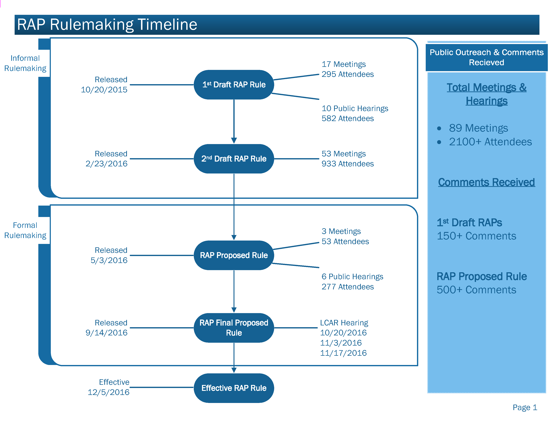

Slide 4

Vermont Clean Water Initiative:
All-In
WWTF
Forest Lands
Developed Lands Including Paved Roads
Unpaved Roads
River Corridors & Floodplains
Wetlands
Ag Lands
Notes:
All-In
Time, Flexibility, Support

Slide 5
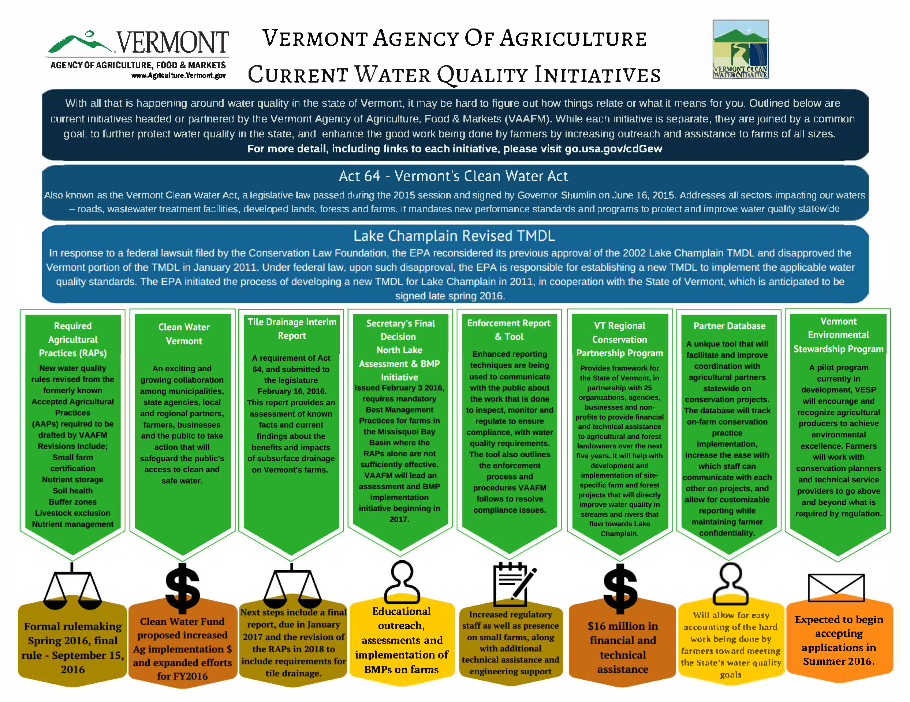

Slide 6
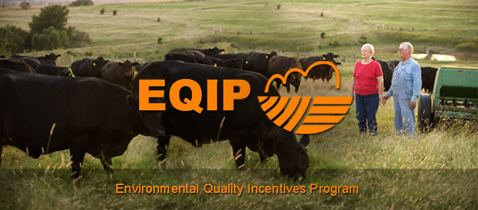
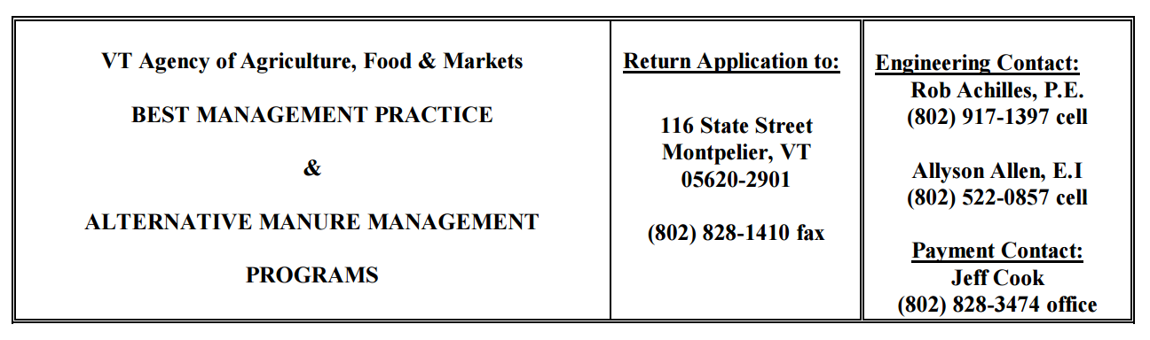
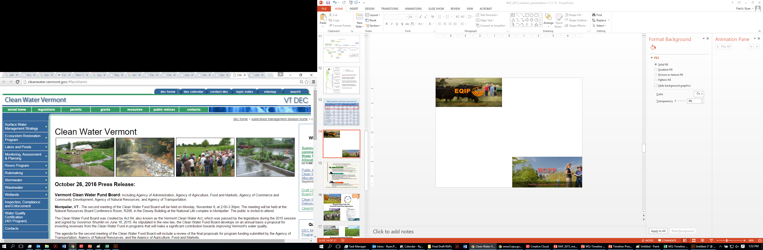
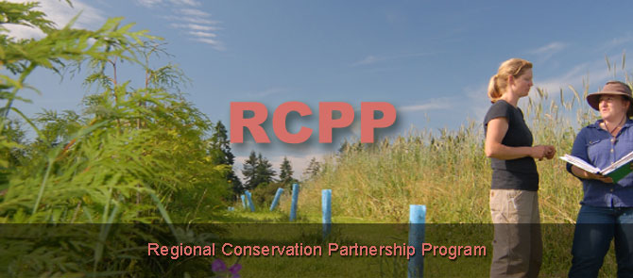
USDA NRCS: $45 million over 5 years
Technical and Financial Assistance Available for all Farms in Vermont
Vermont Clean Water Fund:
$1.75 Million Proposed for Farms
State of Vermont RCPP: $16 million
Long Island Sound RCPP: $10 million
VACD RCPP: $800,000
Memphremagog RCPP: $600K

Slide 7
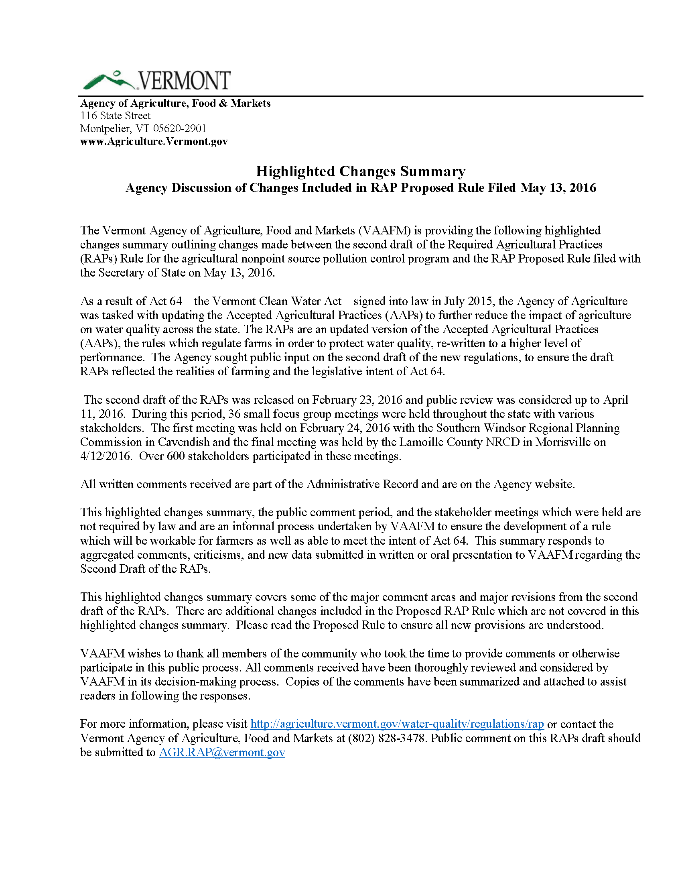
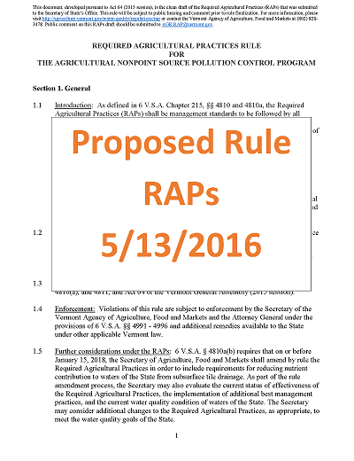
agriculture.vermont.gov/rap
RAP Final Rule
Effective: 12/6/2016

Slide 8
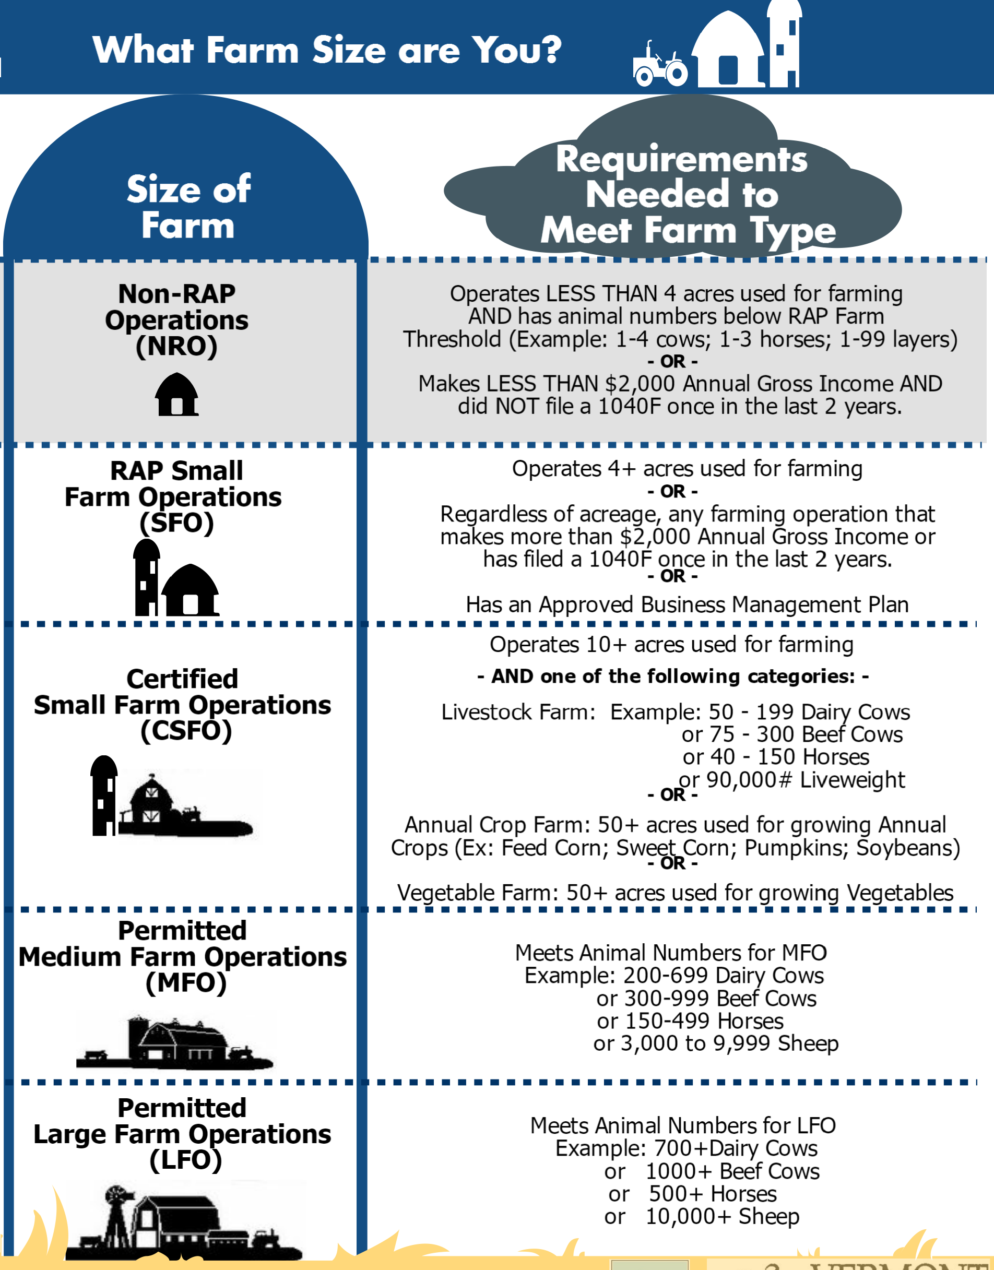
Estimated
# Farms
6000
700
140
27

Slide 9
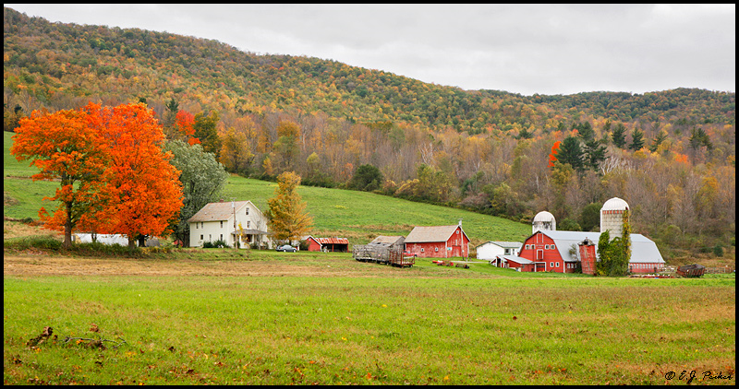
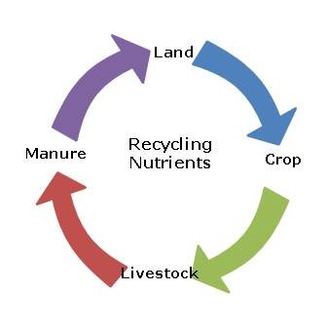
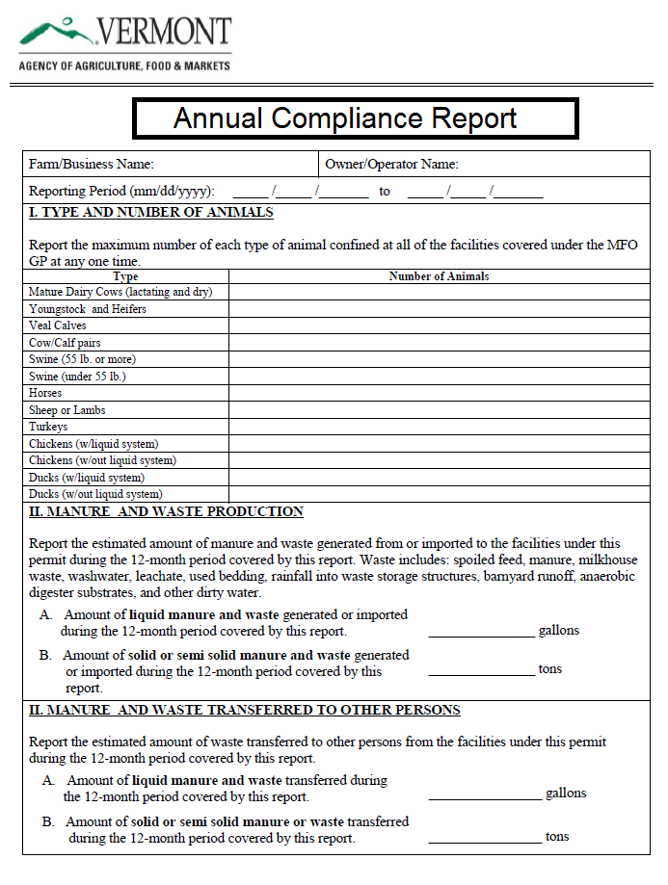
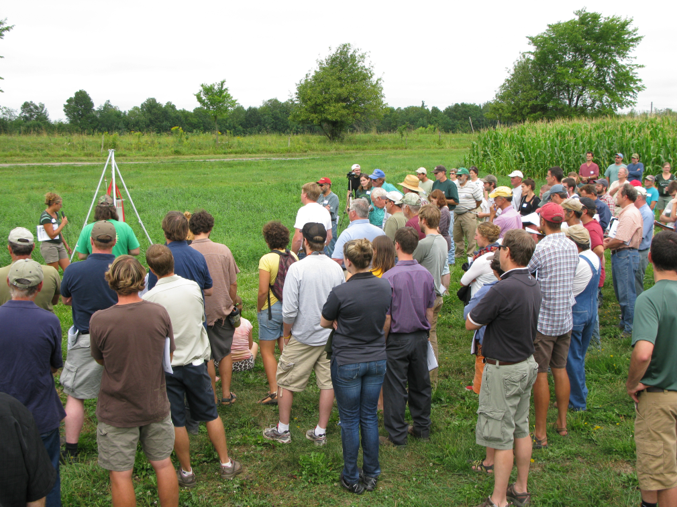
Minimum inspection within 7 years
590 Nutrient management plan required
Requirements Only For:
Certified Small Farm Operations
Required education for farmers
Annually Report Compliance

Slide 10
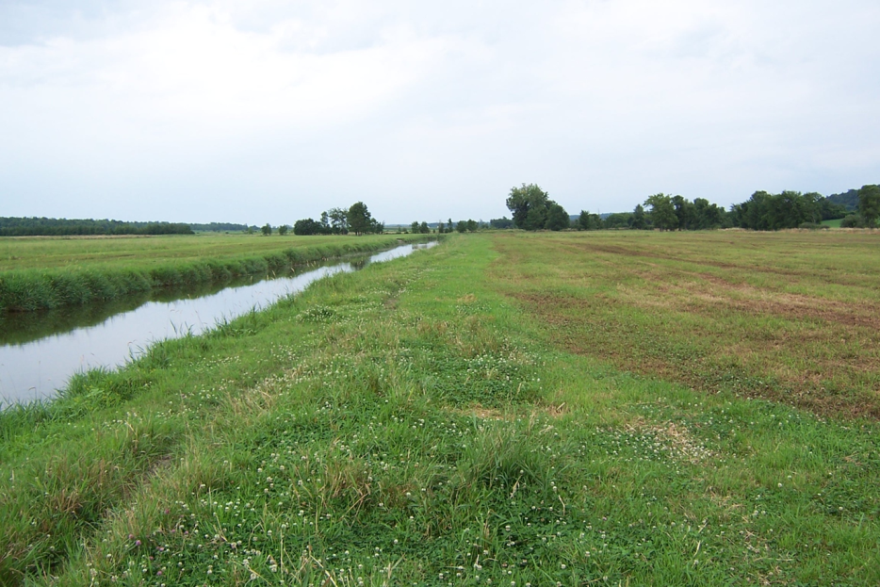
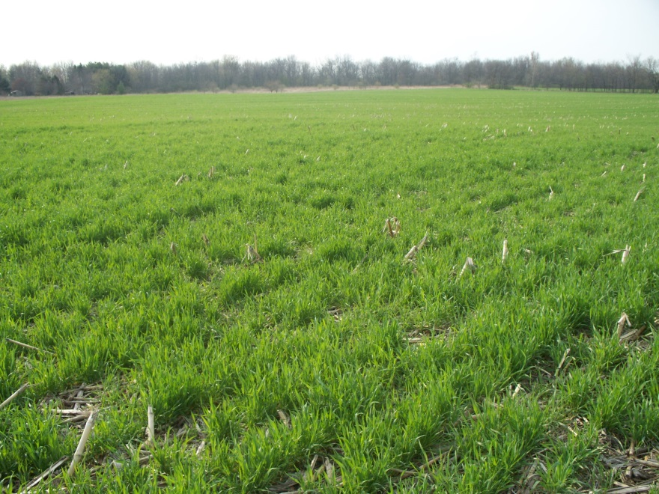
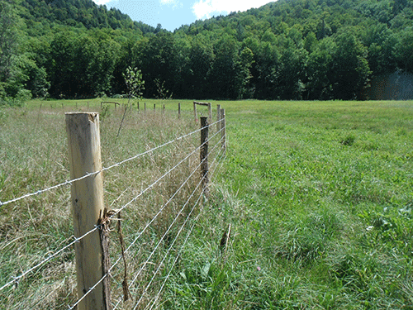
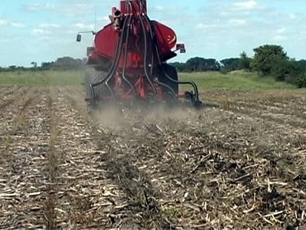
Increased buffers and manure setbacks
(25’ streams and 10’ ditches)
100’ on 10%+ Slope
Cover Crop Floodplains (broadcast by 10/1 or drilled by 10/15)
Required Agricultural Practices:
Certified & Uncertified SFOs
Establish standards for livestock exclusion from waters (3” minimum growth)
Manure Planning for Fields with Soil Test Phosphorus > 20 ppm

Slide 11
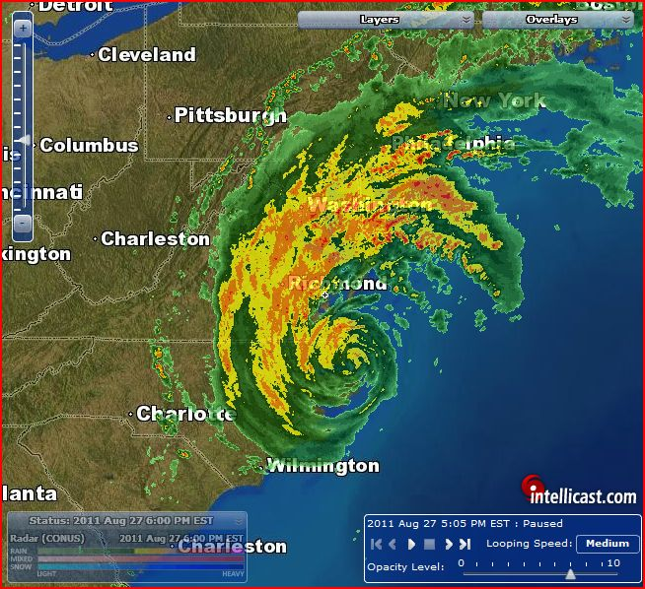
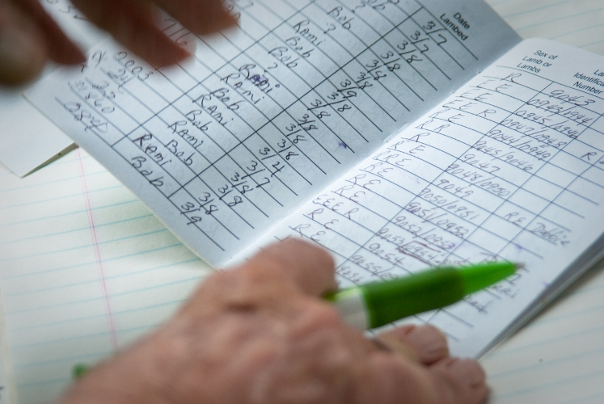
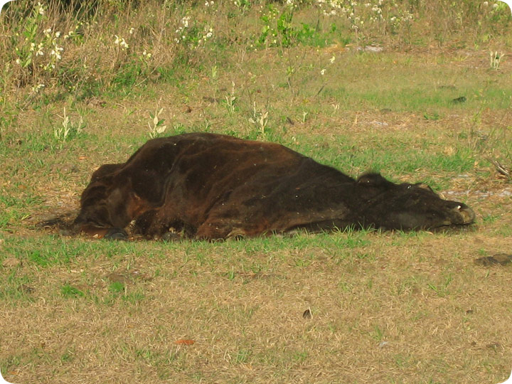
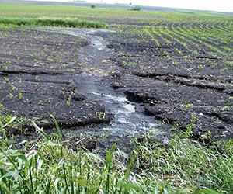
Weather conditions conducive to runoff
Record keeping requirements
Required Agricultural Practices:
Certified & Uncertified SFOs
Manage gully erosion and reduce overall erosion to T
Mortalities must be disposed in 48 hours
§5.3(b)
§5.8

Slide 12
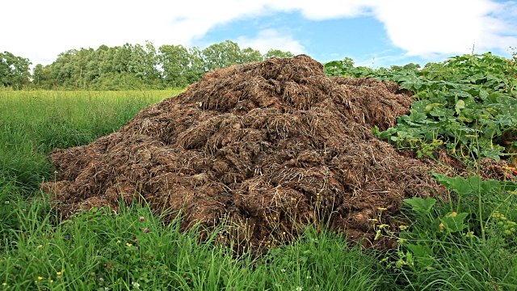
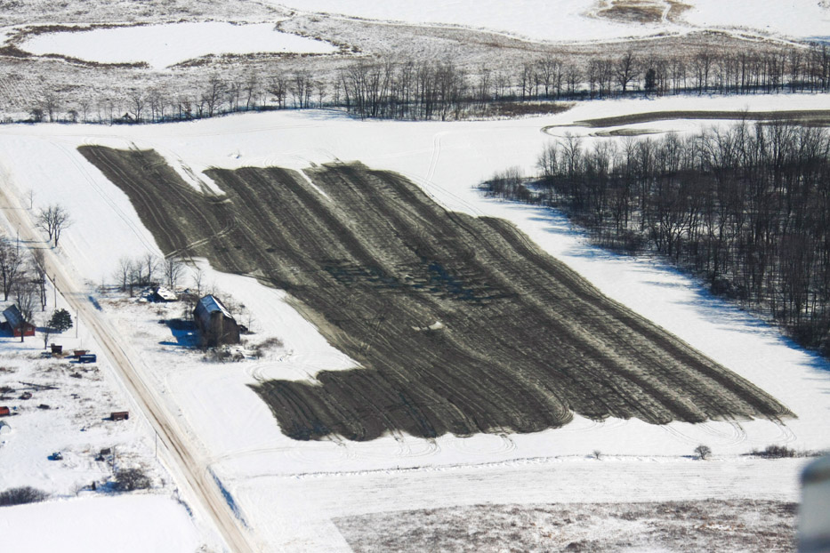
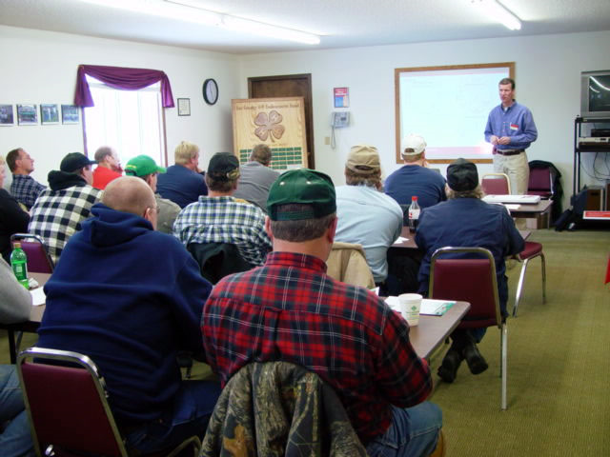
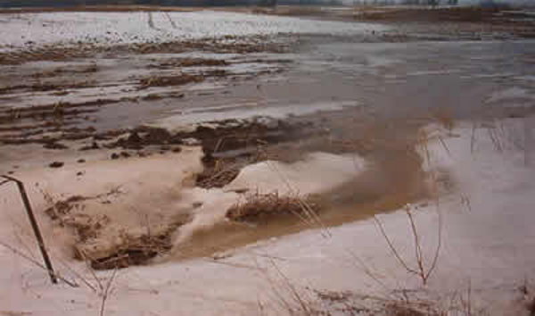
Seasonal winter spreading exemptions
Increased stacking setbacks from water and wells plus active management (2 years)
Required Agricultural Practices:
Certified & Uncertified SFOs
Train & license custom manure applicators
Extended winter spreading ban for annual crop in floodplains (10/15 to 4/15)

Slide 13
AGR.RAP@vermont.gov
Additional Information:
agriculture.vermont.gov/water-quality/regulations/rap
Or:
go.usa.gov/cdGew

Slide 14
Section 3
Activities to be managed by local town / municipality
- Parcels smaller than 4 acres in size and manages
four equines; five cattle, cows, or American bison; 15 swine; 15 goats; 15 sheep;
15 cervids; 50 turkeys; 50 geese; 100 laying hens; 250 broilers, pheasant, Chukar partridge,
or Coturnix quail; three camelids; four ratites; 30 rabbits; 100 ducks; 1,000 pounds of
cultured trout; or
other livestock types, combinations, and numbers as designated by the Secretary
- Parcels smaller than 4 acres that
- Gross less than $2,000 from Ag Sales
- Have not filed a 1040(F) once in last two years
- A farm can demonstrate they are a farm that should be regulated under the RAPs by income or a prospective business plan.
- Secretary can designate that a Non-RAP Operation must follow the RAPs if causing an adverse water quality impact

Slide 15
Section 4
Small Farms Requiring Certification
% Under Permit / Certification
Livestock Farm
Vegetable/Produce Farm
Annual Cropland Farm
10+ acres AND at least 25% of Medium CAFO numbers
50+ Acres used for ‘vegetable’ production
50+ acres used for ‘annual cropland’ production
Where nutrients are applied
Where nutrients are applied
50-199 Dairy Cows
75-300 Beef Cows
40-150 Horses
90,000# + Liveweight
76.4% of All
Liveweight
94% Of All
Dairy Cows
93% of All
Corn for Silage
68% of All
Vegetable
Acreage

Slide 16
Section 4.3
Proposed Requirements Only For:
Certified Small Farm Operations
Annual Compliance Reporting
Minimum inspection within 7 years
590 Nutrient Management Plan Required
Required Education for Farmers
A person who owns or leases a Certified Small Farm shall notify the Secretary of a change in ownership or lease of the whole farm ownership or land base within 30 days.
§4.10(a)

Slide 17
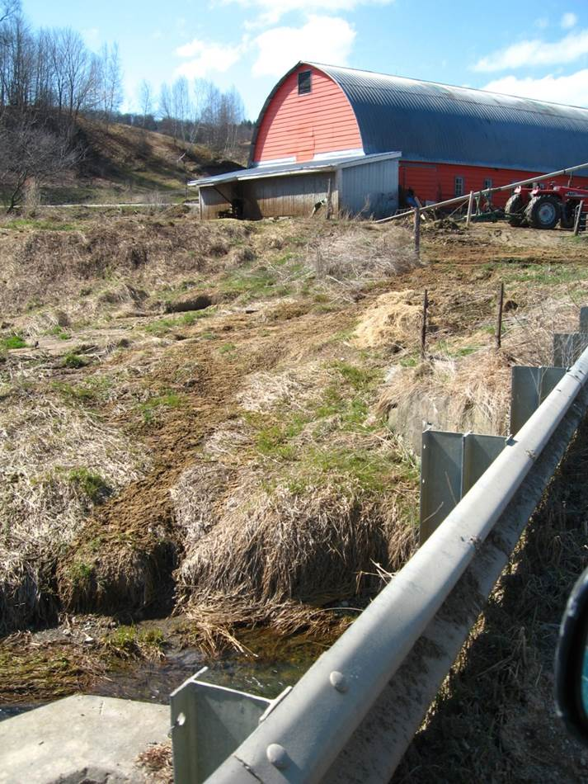
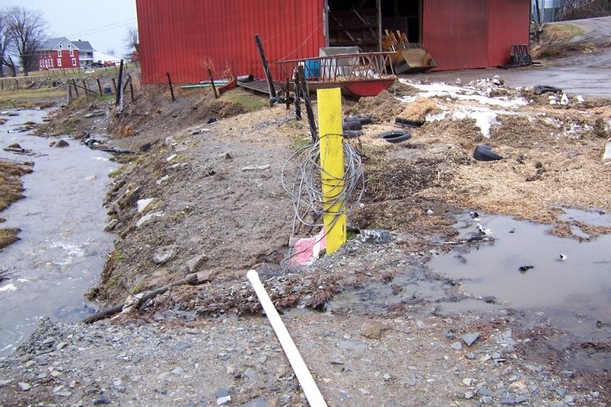
Section 6.01
Discharges:
(a) Farms subject to regulation under these Rules shall not create any discharge of wastes from a production area or waste management system into the surface waters of the State through a discrete conveyance such as, but not limited to, a pipe, ditch, or conduit without a permit from the Secretary of ANR.

Slide 18
Section 6.02
Nutrient, Agricultural Inputs & Waste Storage
Production Areas
Production areas shall utilize runoff or leachate collection, diversion or other management strategy to prevent discharge of waste or indirect discharge to groundwater.
All Ag Wastes shall be properly stored
Waste Storage Facilities:
  Must be properly maintained
  Adequate Volume to prevent overflow
  May be required to meet and certify compliance with NRCS Standard

Slide 19
Section 6.02
Nutrient, Agricultural Inputs & Waste Storage
Field Stacking of Manure
Proposed Changes:
Increased stacking setbacks from water and wells plus 3 year storage maximum
Prohibited to be stacked in a floodway or in an area subject to annual flooding
If not approved consistent with NRCS Standards or Approved by Secretary:
Manure stacks must meet the following setbacks:
  100’ from property lines
  200’ from top of bank of surface waters
  200’ from public or private water supplies
  200’ from any public water supply
  100’ from ditches, or conveyance to surface water
  As authorized by Secretary—no less than 100’ top of bank surface water or well
Field Stacks shall be land applied or exported within two years
Notes:
Do we want to add a bullet about field stack location and having to change it every 180 days

Slide 20
Section 6.03
Nutrient Management Planning
Proposed Changes:
590 Nutrient management plan required for certified SFOs
Record keeping requirements
All MFO, LFO, and Certified SFOs shall develop and implement a Nutrient Management Plan (NMP) which meets USDA NRCS Nutrient Management Plan Practice Code 590
All other farming operations
All sources of nutrient shall be accounted for when determining recommended application rates of manure.
All fields which receive mechanical application of manure and other wastes shall be soil sampled once ever 5 years.
  Plans and records of application rates shall be maintained for 5 years.

Slide 21

Section 6.04
Soil Health Management Recommendations: Cover Crop Requirements
Manage gully erosion and reduce overall erosion to T
Cover Crop Floodplains (broadcast by 10/1 or drilled by 10/15)
Annual croplands subject to flooding are required to plant cover crops.
  Broadcast by October 1
  Drilled by October 15
USDA Soil Survey Flooding Frequency Class:
  “Frequently Flooded”
30% Residue after Oct 15
Cropland shall be cultivated so that average soil loss will be less than or equal to the tolerable soil loss (T) for a particular soil. RUSLE2
Field born gully erosion will be managed through appropriate BMP.

Slide 22
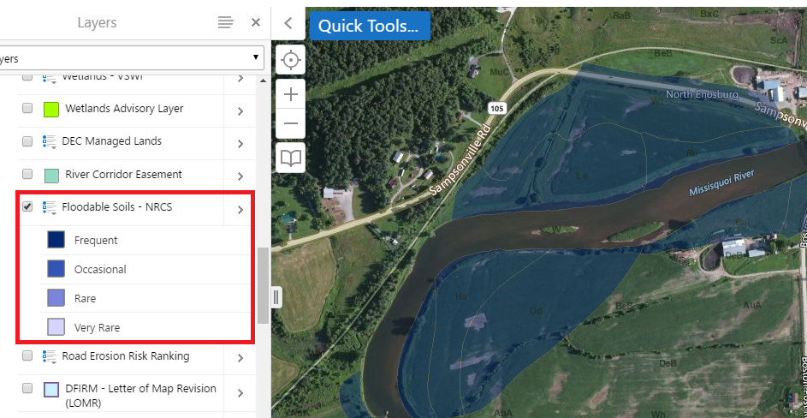
Shortened url: go.usa.gov/cddEz
"Frequent" means that flooding is likely to occur often under normal weather conditions. The chance of flooding is more than 50 percent in any year but is less than 50 percent in all months in any year.

Slide 23
Section 6.05
Proposed Winter and Floodplain Manure & Ag Waste Application Standards
Winter Spreading Restrictions
Floodplain Restrictions
No Manure or Waste application spread on all fields between
December 15 and April 1
Manure may not be spread within frequently floodable soils as defined by NRCS soils layer:
After October 16 or Before April 14
Winter Spreading Ban
Secretary may prohibit between 12/1-12/15 and 4/1-4/30 of any calendar year
Emergency exemptions
Must injected or incorporate within 48 hrs
  Does not apply to no-till

Slide 24
Section 6.06
Winter Manure Spreading Restrictions & Exemptions
Seasonal winter spreading exemptions
including frequently flooded floodplain fields
RAPs revise and set new standards for winter manure and wastes spreading ban.
  Requirements for requests
  Standards for approvals
  Guidelines for manure application
  Includes options for exemptions from restrictions on frequently flooded fields

Slide 25

Section 6.05
Manure & Waste Application Standards
When Weather conditions conducive to runoff
No Manure Application on bedrock, frozen, saturated or snow covered ground (unless approved in advance)
Manure and other wastes shall not be spread when field conditions are conducive to flooding, runoff, ponding or other off site movement or can be reasonably anticipated to result in flooding, runoff, ponding or other off site movement

Slide 26
Section 6.03 & 6.05(f)
Proposed Manure & Waste Application Standards
For 590 NMPs:
Required P Reduction Strategy when annual cropland, grass, hayland STP reaches > 20 ppm Modified Morgan
No Manure Application on annual, vegetable small grain cropland w/ slopes > 10% w/o 100’ grass buffer & manure setback

Slide 27
Section 6.07
Vegetated Buffer Zones & Setbacks
Increased buffers and manure setbacks
(25’ surface water and 10’ ditches)
Buffer Zone Requirements
Surface Water shall be buffered 25’
Ditches shall be buffered 10’
Surface inlets or open drains shall be buffered from croplands by 25 feet of perennial vegetation
Harvesting of Vegetated Buffer is Allowed
No spreading manure or wastes in the vegetated buffers
Fertilizer and compost may be used per NMP to establish or maintain buffer
No Tillage Allowed in Buffer except for establishment or Maintenance
Site Specific Variances
Variances for vegetated buffers may be considered based on a site specific characteristics
Notes:
A vegetative buffer zone of perennial vegetation shall be maintained between annual croplands and the top of the bank of adjoining surface waters

Slide 28
Section 6.08
Animal Mortality Management & Composting
Mortalities must be disposed in 48 hours
Animal mortalities being disposed of on the farm within 48 hours according to the following standards:
  Compost
  Burial
  Render
On-Farm Composting of Imported Food Processing Residuals
Notes:
Burials
(i) minimum of 150 feet from property lines and surface waters.
(ii) minimum of 3 feet above the seasonal high water table.
(iii) covered with a minimum of 24
inches of soil
(iv) 200 feet from public or
private drinking water supplies
Mortalities
on farm property shall be sited so
as to be:
minimum of 150 feet from all
property lines and surface waters.
(ii) not on land subject to annual overflow from adjoining surface waters.
(iii) minimum of 300 feet from neighboring residences and public buildings

Slide 29
Section 7
Proposed Livestock Exclusion Standards
Establish standards for livestock exclusion from waters.
Production & Pasture Areas
(3” minimum growth in buffer zones—25’/10’)
Production Area & Immediately Adjacent areas
No Access to Surface Water except:
  At defined crossing
  Where prescribed rotational grazing plan exists (3” residual)
  In areas approved by Secretary
  Adequate vegetative cover shall be maintained to protect
  banks of surface water
Outside Production Area (Pasture)
Livestock shall not have access to surface water outside of production area that:
Have unstable banks of surface water
Areas designated by Secretary where actual or potential threat exists

Slide 30
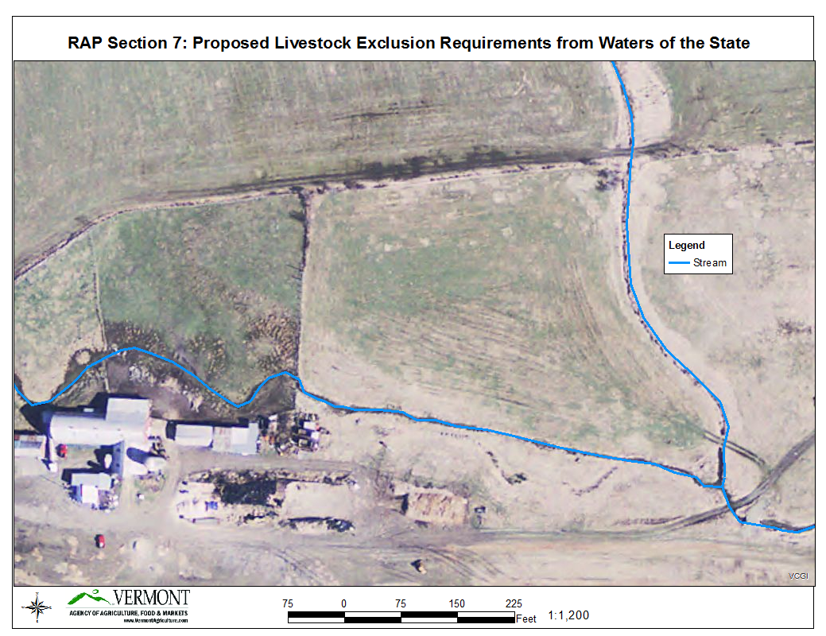
This presentation provides one example of where fencing to keep livestock out of surface water would be required on a farm.
First, it is important to define where is the “Production Area”

Slide 31
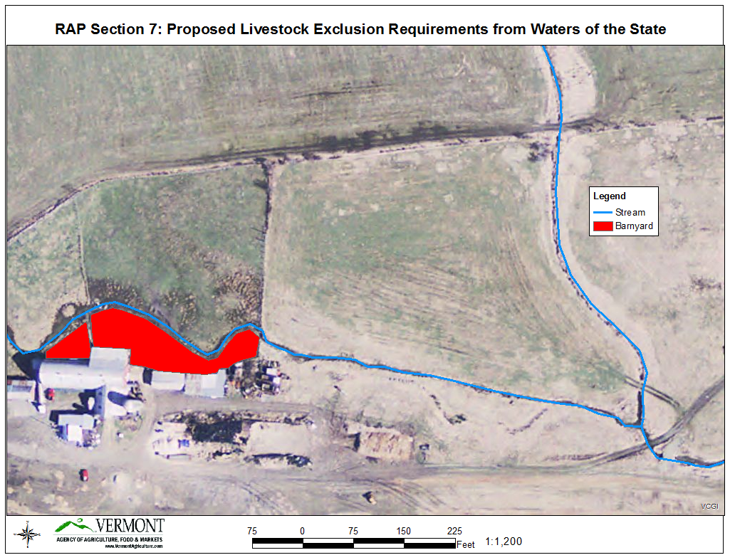
This farm has a barnyard which allows livestock access to a stream which flows adjacent to the main barn. This is one major component of a Production Area

Slide 32
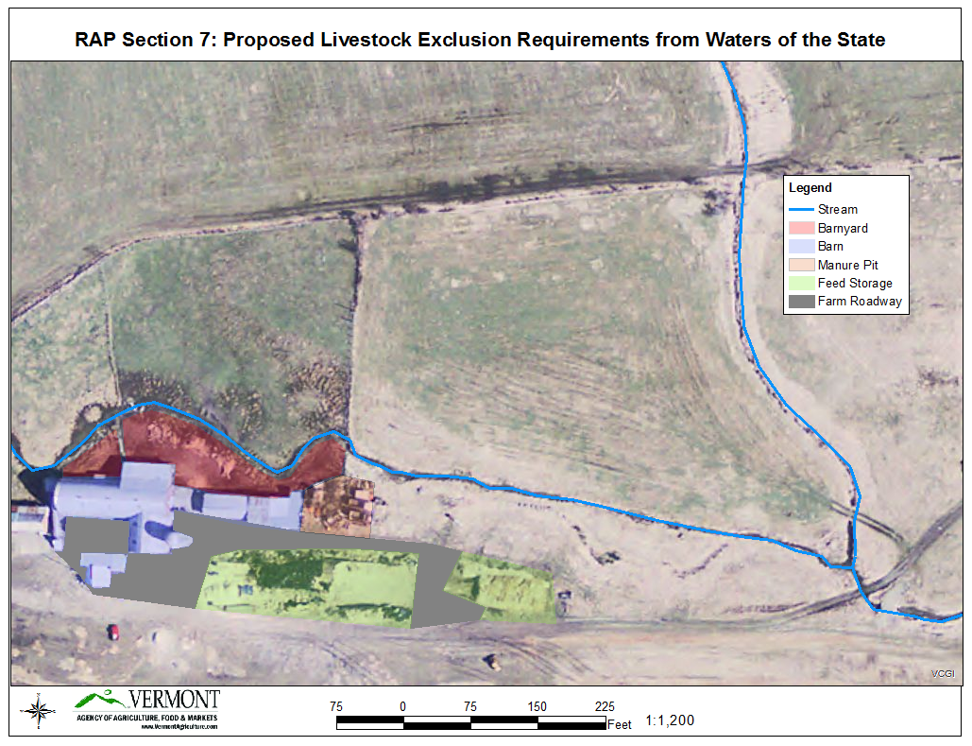
Also included in the production area are the farm roadways.

Slide 33
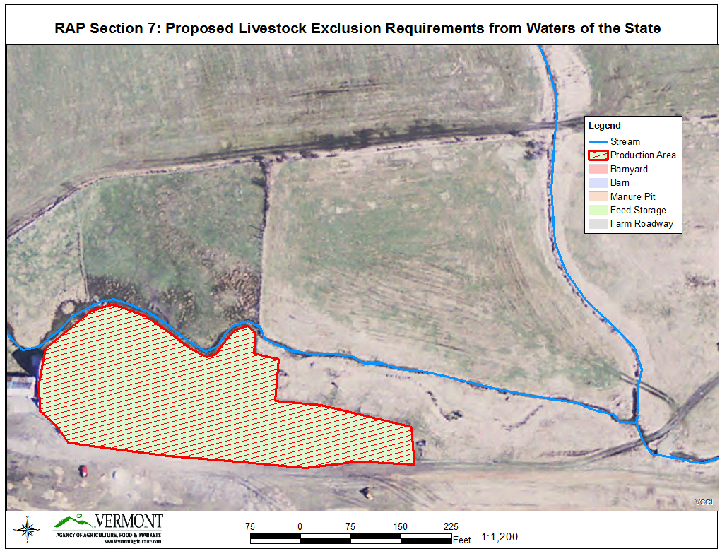
All these areas together make up the “Production Area” which is highlighted below.

Slide 34
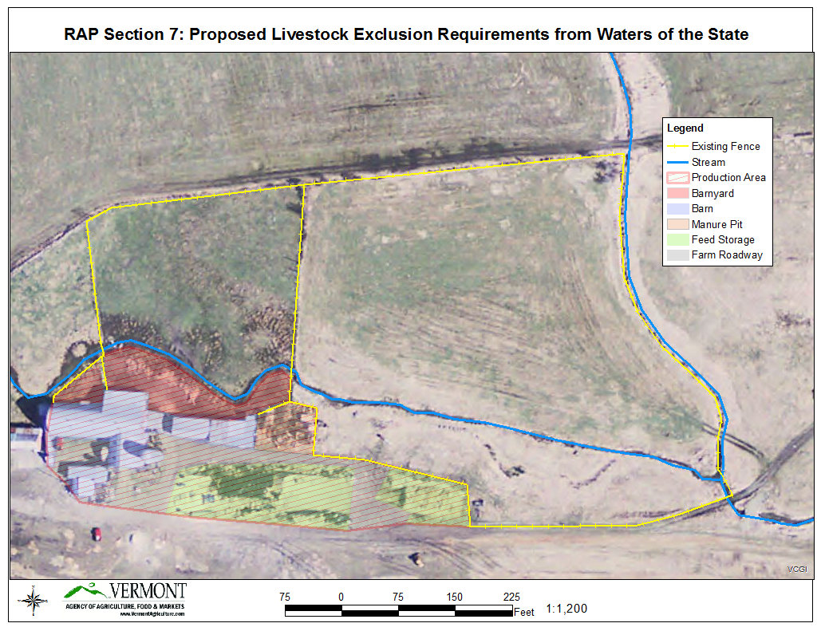
Highlighting the existing fencing on the farm, we see that livestock currently have access to surface water on two stretches of river:
Year-Round Livestock Access
Summer Livestock Access

Slide 35
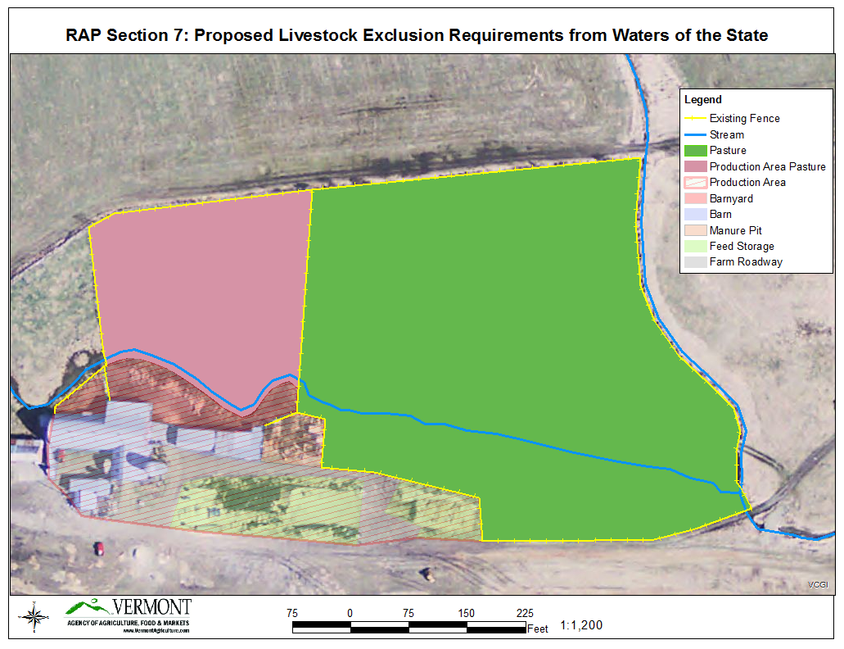
Using the language from Section 7, we can now identify two different areas of pasture: Production Area Pasture & Pasture (outside of the production area)
Production Area
Pasture
Pasture

Slide 36
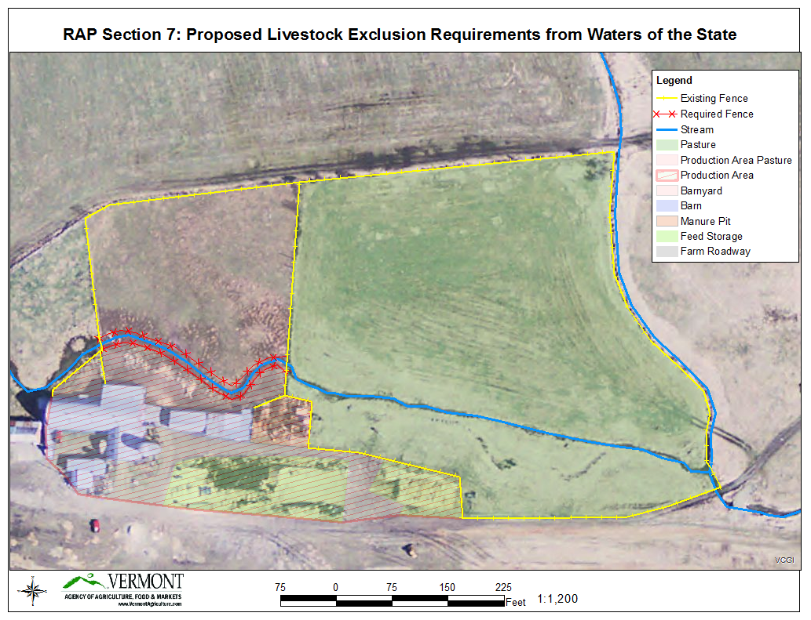
The section of stream which runs through the Production Area and Production Area Pasture would be required to be fenced off from livestock access.
No Fencing Required
Unless Erosion Present
Required Fencing

Slide 37
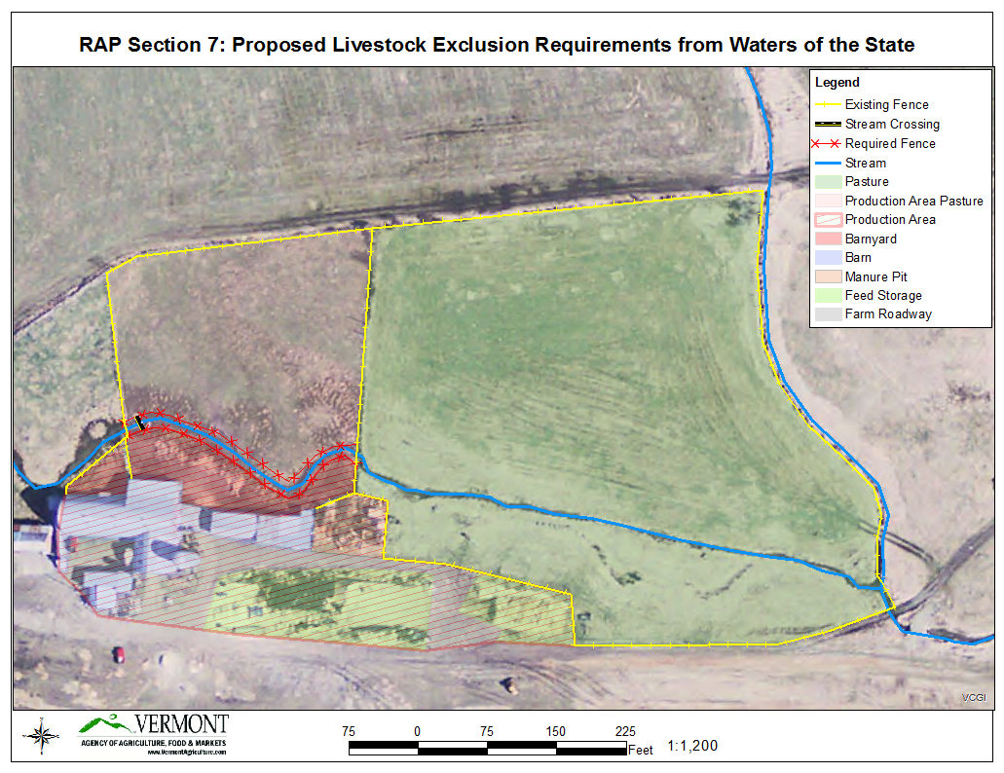
A discrete point on the stream could be used as a stream crossing or watering area in the production area.
Can Cross & Water at Defined Areas

Slide 38
With an approved Grazing Management Plan, a farmer could graze this area leaving no less than 3” of vegetative growth

Slide 39
Section 10
Custom Applicator Certification
Train & license custom manure applicators
Custom Manure Applicators shall be certified by the Secretary
  Must demonstrate knowledge of RAPs and NRCS 590 standard
  Must demonstrate competency in methods and techniques to ensure appropriate nutrient application in compliance with environmental standards.
Certified custom manure applicators shall train all employees and seasonal workers in methods and techniques to meet RAP and NRCS 590 standards for nutrient application
Certification is valid for 5 years; Shall complete 8 hours of training in each 5 year period.

Slide 40
Section 9
Construction of Farm Structures
Construction of farm structures in Flood Hazard Areas and River Corridors are required to obtain a Flood Hazard Area and River Corridor permit from ANR
Prior to construction of farm structures, the farmer must notify the zoning administrator or town clerk in writing of the proposed activity
  Must contain a sketch of the proposed structure including the setbacks from adjoining property lines, roads and right-of-ways
The Secretary may grant a variance to municipal and local setbacks that will represent the minimum alternative that will afford relief and will represent the least deviation possible from these regulations
Following minimum setbacks for all new WSF:
  100 feet from centerline of public road
  100 feet from abutting property line
  100 feet from the top of bank of any surface water
  200’ from public or private wells

Slide 41
Section 11
Site Specific On-Farm Conservation Practices
When the Secretary determines, after inspection of a farm, that a person engaged in farming is complying with the Required Agricultural Practices Rule but there still exists the potential for agricultural pollutants to enter the waters of the State, the Secretary shall require the person to implement additional, site-specific, on-farm conservation practices designed to prevent agricultural pollutants from entering the waters of the State.
When requiring implementation of a conservation practice, the Secretary shall inform the person engaged in farming of the resources available to assist the person in implementing the conservation practices and complying with the requirements.

Slide 42
Requirement of RAPs | Cost of Implementation | FA Available | C/S Rate | Supporting Benefit in addition to FA
Cover Crop Frequently Flood Annual Crop Fields | $89/ac (Seed = $40 / ac for 100# rate) | $67 /ac or $79/acre (NRCS EQIP Practice Code 340) | 75% to 90% | 40# N Credit in Spring or 1 T DM / Ac break even for double cropping
Nutrient Management Plan Development (CSFO) | $3,095 / 150 ac. farm | $2,321 / 150 ac. Farm (NRCS EQIP Practice Code 104) | 75% to 90% | University Programs available to support farmer development of their own plan 21.7% Average Fertilizer Usage decrease Post-NMP (Darby, 2016) Increases rate of adoption of supporting Conservation Practices
25' Vegetated Buffer on Surface Water | $468 / ac or $850 / ac | $680 / ac (NRCS Practice Code 512) | 75% to 90% | Numerous opportunities exist to support farmers in installing vegetated buffers on surface waters Many scenarios include consideration for 'forgone income' of changing land use (from corn to hay) Agency will be launching VT Critical Area Seeding & Filter Strip Program: available to pay for spot installation of grassed waterways, also to support farmers to leave hayable buffers when rotating from hay to corn

Slide 43
Vegetative Buffer Zone Programs
US Department of Agriculture (USDA) Natural Resources Conservation Service (NRCS) Environmental Quality Incentives Program (EQIP) has significant technical and financial assistance resources available to provide FA and TA to farmers to install vegetative buffer zones.
  Practice Code 512: Forage and Biomass Planting (Cool Season, Establish or Reseed, Foregone Income)
    Payment Rate $ 680.86 /Ac.
  Practice Code 393: Filter Strip (Filter Strip, Introduced species: Forgone Income)
    Payment Rate: $ 522.71 / Ac.
  Practice Code 386 :Field Border (Field Border-Native, Inc Forgone)
    Payment Rate: $ 624.58 / Ac.
Conservation Reserve Enhancement Program (CREP):
  It is important to note the CREP is used to install Riparian Forest Buffers—non-harvestable woody buffers. These buffers are above and beyond what is required by the RAPs.
  http://agriculture.vermont.gov/sites/ag/files/PDF/statewide%20crop%20average%20rate%20CREP%20brochure3a%20updated.pdf
  Total funds over the 15 year contract period: $2,005 + $2,820 = $4825/acre or $321.67/acre/yr.
Vermont Critical Area Seeding and Filter Strip Program
  http://legislature.vermont.gov/statutes/section/06/215/04900
  The Vermont Agency of Agriculture, Food & Markets will be developing policy and payment rates for this program to launch in the spring.
  This will be a state administered program that farmers would be able to use to implement harvestable vegetated buffers on their farms.
USDA EQIP
VAAFM Critical Area Seeding and Filter Strip Program
512: Forage and Biomass Planting
  (Cool Season, Establish or Reseed, Foregone Income)
  Payment Rate $ 680.86 /Ac.
393: Filter Strip
  (Filter Strip, Introduced species: Forgone Income)
  Payment Rate: $ 522.71 / Ac.
386: Field Border
  (Field Border-Native, Inc Forgone)
  Payment Rate: $ 624.58 / Ac.
Hayable Buffers
Grassed Waterway Establishment
Launch by spring 2015
Will Replace Vermont Ag Buffer Program
CREP
$4825/acre
or $321.67/acre/yr.

Slide 44
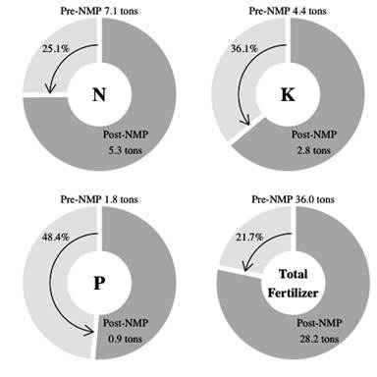
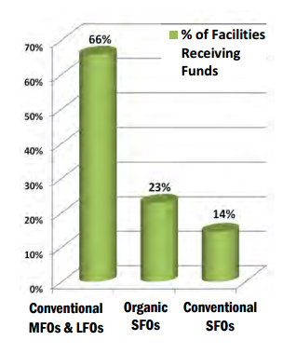
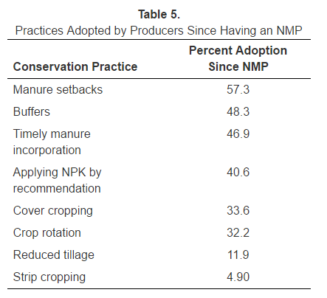
RAPs: Technical and Financial Assistance Opportunities

